Slide 1
Multi-Genre Research Project
Credit: Mary Kay Seales
Senior English Language Fellow

Slide 2
What is a Multi-Genre Research Paper?
•"A multi-genre paper arises from research, experience, and imagination. It is not an uninterrupted, expository monolog nor a seamless narrative nor a collection of poems. A multi-genre paper is composed of many genres and subgenres, each piece self-contained, making a point of its own, yet connected by theme or topic and sometimes by language, images, and content. In addition to many genres, a multi-genre paper may also contain many voices, not just the author's. The trick is to make such a paper hang together.”
(Romano, Blending Genre, Altering Style)

Slide 3
What’s a genre exactly?
•Journal Entries
•Personal Letter
•Greeting Card
•Schedule/Things to Do List
•Inner Monologue Representing Internal Conflicts
•Classified or Personal Ads
•Personal Essay or Philosophical Questions
•Glossary or Dictionary of important or cultural words
•Poetry
•Song Lyrics
•Autobiographical Essay
•Contest Entry Application
•Business Letter or Correspondence/Persuasive or Advocacy Letter

Slide 4
Genre cont.
•Critique of a Published Source
•Speech or Debate
•Historical Times Context Essay
•Textbook Article
•Science Article or Report/Business Article or Report
•Encyclopedia Article
•Short Scene from a Play with Notes for Stage Directions
•Biographical Summary
•Dialogue of a Conversation among Two or More People
•Short Story
•Adventure Magazine Story
•Ghost Story

Slide 5
Genre Cont.
•Talk Show Interview or Panel
•Recipe and Description of Traditional Holiday Events
•Myth, Tall Tale, or Fairy Tale
•Character Analysis or Case Study
•Comedy Routine or Parody
•Liner Notes
•Picture book
•Chart or Diagram with Explanation and Analysis
•Brochure or Newsletter
•Time Line or Chain of Events
•Map with Explanation and Analysis
•Magazine or TV Advertisement or Infomercial

Slide 6
Genre cont.
•Travel Brochure Description
•How-To or Directions Booklet
•Receipts, Applications, Deeds, Budgets or Other Documents
•Wedding, Graduation or Special Event Invitation
•Birth Certificate
•Local News Report
•Pop-Up book
•Review and Poster for a Movie, Book, or TV Program
•Board Game or Trivial Pursuit with Answers and Rules
•Comic Strip or Graphic Novel excerpt
•Restaurant Description and Menu

Slide 7
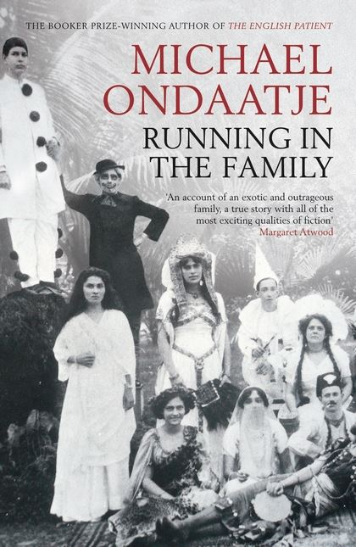
Some Examples
http://www.users.miamioh.edu/romanots/pdf/nativedarkness.pdf

Slide 8
Criteria
The minimum requirements:
Title Page
Table of Contents
Preface: Introduction to your project
Photos
Timeline
Non-Fiction as well as creative writing.
Last Page: Works Cited Page MLA format
You must use at least 7 genre in the paper

