Slide 1
Gender and Identity http://www.youtube.com/watch?v=iGoC8FTLKSI

Slide 2
In this unit we will explore:
The definitions of gender and sex
How these are developed
How they effect us and who we are
Gender stereotyping

Slide 3
Jenna Talackova (article)

Slide 5
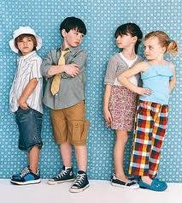
Act Like a Man / Be Ladylike

Slide 6
Act like a man (Stereotypes- from class)

Slide 7
Be ladylike (Stereotypes- from class)

Slide 8
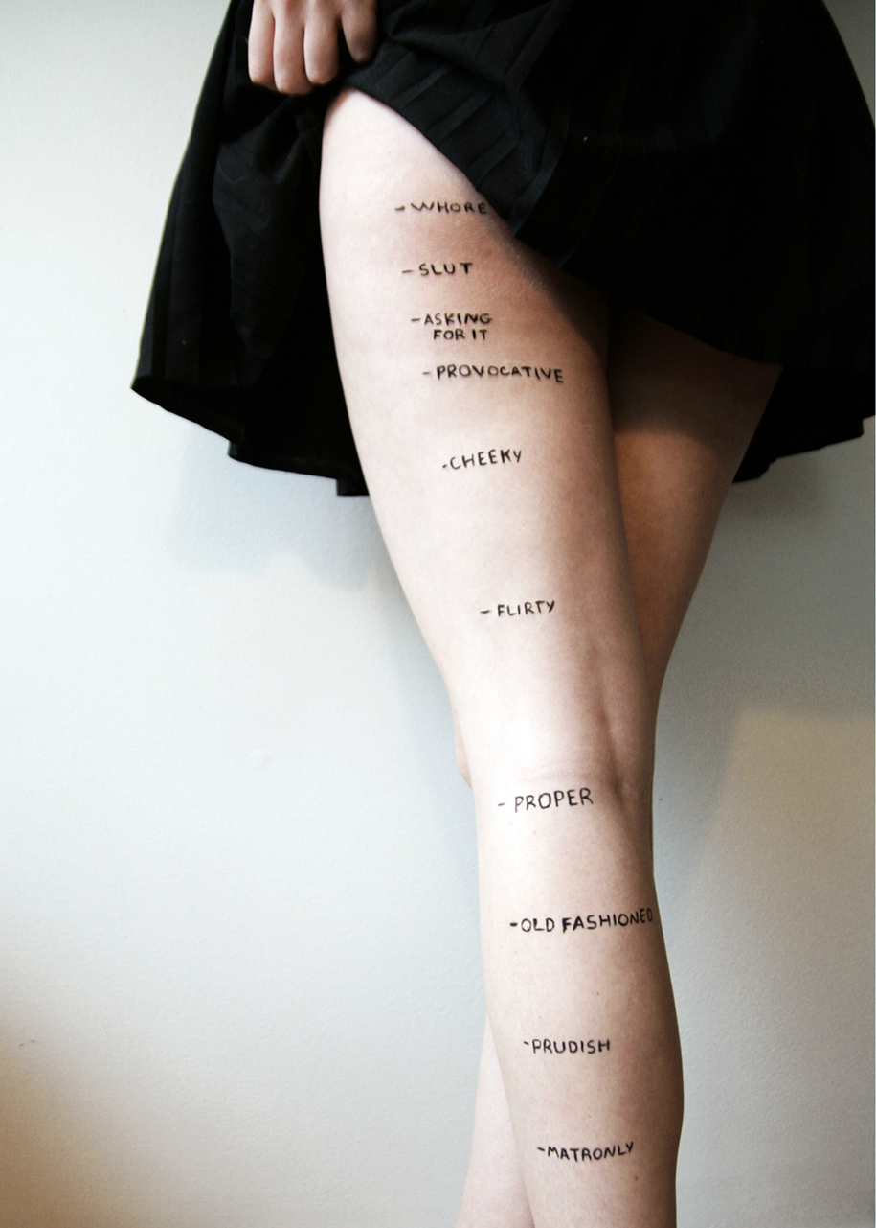

Slide 9
Important Point: it's not wrong for guys to like sports or fix cars or for girls to enjoy cooking or playing with babies.
The problem is that we are told that we must perform these roles in order to fit in. It is important for all of us to make our own decisions about what we do.
Stereotypes are problematic in that they take away our personal choices in determining our own interests and skills.
They also discourage men from participating in "women's work" and restrict women from choosing roles that are traditionally "male"

Slide 10
What is Gender?
the behaviour that a culture associates with femininity and masculinity. They are context/ time-specific and changeable.
Gender determines what is expected, allowed and valued in a woman or a man in a given context.
What does this mean…..?

Slide 11
What is Sex?
'Sex' refers to biological characteristics which define humans as female or male. These biological characteristics are not mutually exclusive however, as there are individuals who possess both.

Slide 12
What is Sex and Gender? Overview
http://www.youtube.com/watch?v=xXAoG8vAyzI

Slide 13
THINKING POINTS:
Make a list of some specific ways in which boys and girls are socialised in to their gender roles.
Do you think that traditional gender roles are reinforced by the education system?
How might families socialize children?
How might the media socialize children?
What about stores and advertising?

Slide 14
Gender: Nature vs Nurture- What do you think?

Slide 15
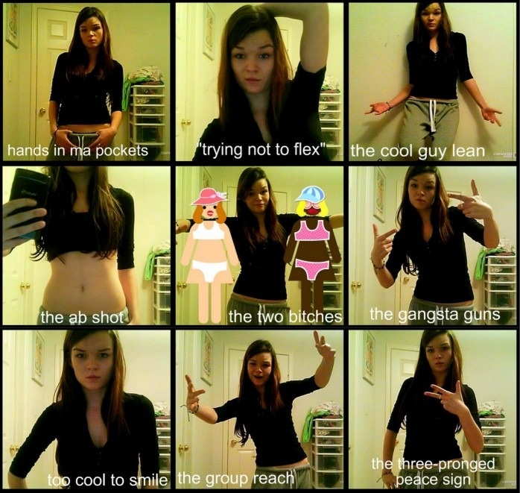
Dumb Guy Poses

Slide 16
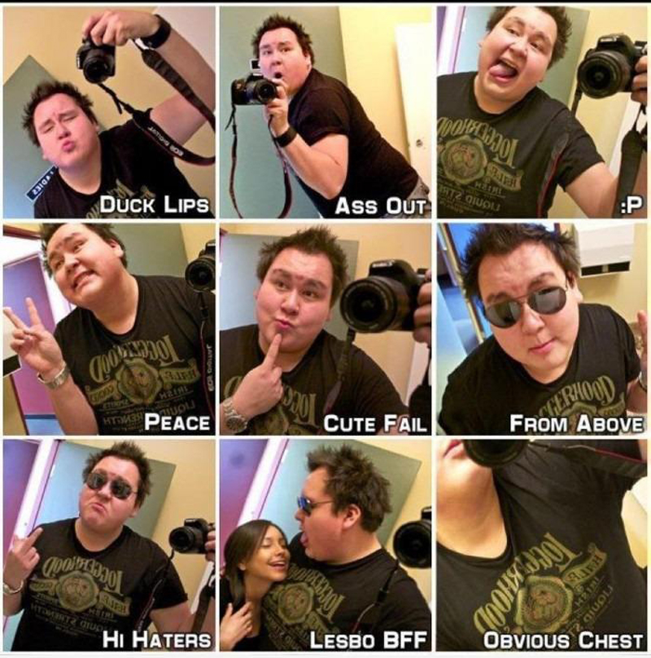
Dumb Girl Poses

Slide 18
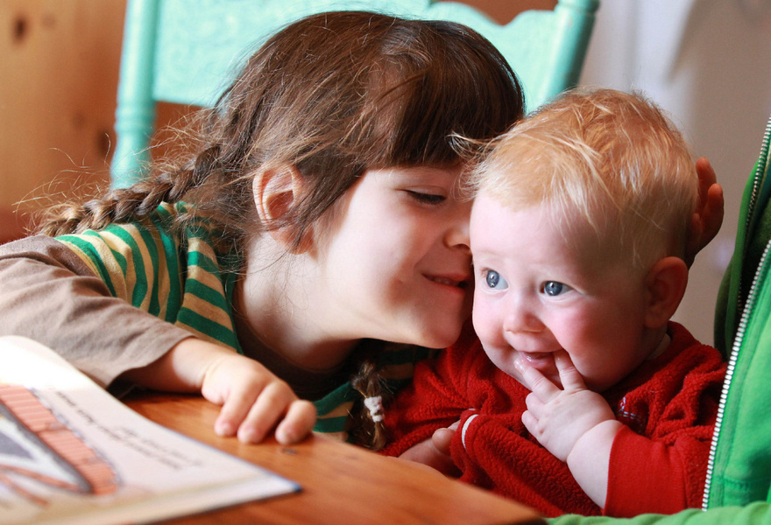
Baby Storm (4 mo) and brother Jazz

Slide 19
What are your opinions on the decision that Baby storm’s parents made to keep his/ her identity a secret?
What are some potential positive outcomes of this?
What are some potential negative outcomes of this?

Slide 20
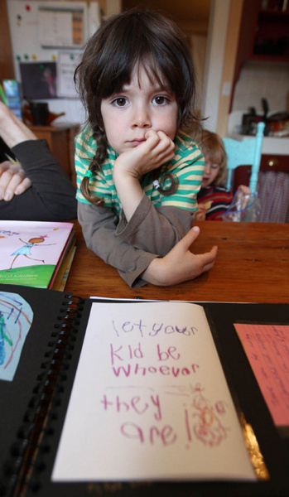

Slide 21
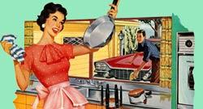
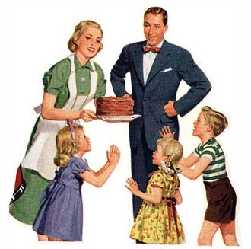
How do you think gender roles have changed for men and women over the last 50 years?

Slide 22
From a 1950's high school home economics textbook, teaching girls how to prepare for married life.
1. Have dinner ready: Plan ahead, even the night before, to have a delicious meal on time. This is a way of letting him know that you have been thinking about him, and are concerned about his needs. Most men are hungry when they come home and the prospects of a good meal are part of the warm welcome needed. 2. Prepare yourself: Take 15 minutes to rest so you will be refreshed when he arrives. Touch up your make-up, put a ribbon in your hair and be fresh looking. Be a little gay and a little more interesting. He may need a lift. 3. Clear away the clutter. Make one last trip through the main part of the house just before your husband arrives, gathering up school books, toys, paper, etc. Then run a dust cloth over the tables. Your husband will feel he has reached a haven of rest and order, and it will give you a lift, too. 4. Prepare the children: Take a few minutes to wash the children's hands and faces if they are small, comb their hair, and if necessary, change their clothes. They are little treasures and he would like to see them playing the part. 5. Minimize the noise: At the time of his arrival, eliminate all noise of washer, dryer, dishwasher or vacuum. Try to encourage the children to be quiet. Be happy to see him. Greet him with a warm smile and be glad to see him. 6. Things to avoid: Don't greet him with problems or complaints. Don't complain if he's late for dinner. 7. Make him comfortable: Have him lean back in a comfortable chair or suggest he lie down in the bedroom. Have a cool or warm drink ready for him. Arrange his pillow and offer to take off his shoes. Speak in a low, soft, soothing and pleasant voice. Allow him to relax and unwind. 8. Listen to him: You may have a dozen things to tell him, but the moment of his arrival is not the time. Let him talk first. 9. Make the evening his: Never complain if he does not take you out to dinner or to other places of entertainment; instead, try to understand his world of strain and pressure, his need to be home and relax. 10. The goal: Try to make your home a place of peace and order where your husband can relax.

Slide 23
How do you think gender roles will change in the next 50 years?

Slide 24
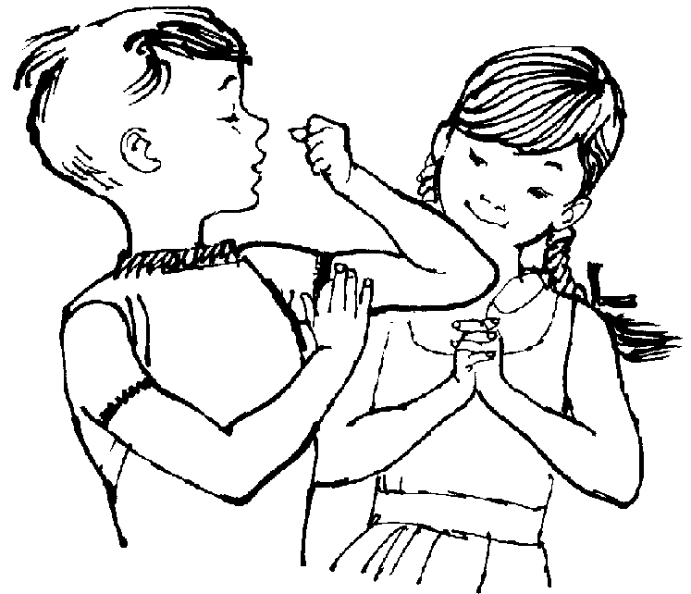
Stratham (1986) found that by the age of five, most children have acquired a clear gender identity. They know what gender they belong to and they have a clear idea of what constitutes appropriate behaviour for that gender.

Slide 25
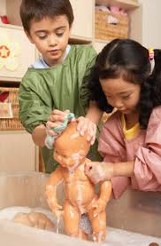
What Psychologists say about Gender:
Read article-
Questions and discuss

Slide 26
What do the following clips teach us about what it means to be a man or a woman? What Gender Stereotypes do you notice?
Do you agree with these messages?
(Man’s last Stand)
http://www.youtube.com/watch?v=2RyPamyWotM
(Woman’s last stand) - NOTE- F-word used)
http://www.youtube.com/watch?v=ou5Ens-qNRc&feature=related
(Superbowl- manvertising)
http://www.youtube.com/watch?v=lc-g-0Q0qb0&feature=related
(Sh** girls say)
http://www.youtube.com/watch?v=u-yLGIH7W9Y
http://www.youtube.com/watch?v=cSIEXtDElOM&feature=related
http://www.youtube.com/watch?v=77lPjNhL5X4&feature=youtu.be (Laci Green- Men and Feminity)

Slide 27
What do the following clips teach us about what it means to be a man or a woman? What Gender Stereotypes do you notice?
Do you agree with these messages? Why, why not?

Slide 28
Born as a boy, raised as a girl
The story of David Reimer
http://www.youtube.com/watch?v=3GhbVFjIaN0
Killing us Softly, advertising and gender

Slide 29
Sex and Gender Activity-
Mayfair mall visit and analysis of how gender is being promoted and sold.
http://www.upworthy.com/boom-roasted-heres-why-you-dont-ask-a-feminist-to-hawk-your-sexist-product?g=2&c=ufb1 (Lady Pens)

Slide 30
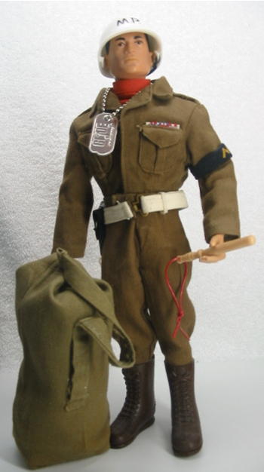
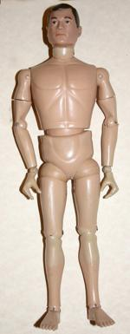
GI JOE (1964)

Slide 31
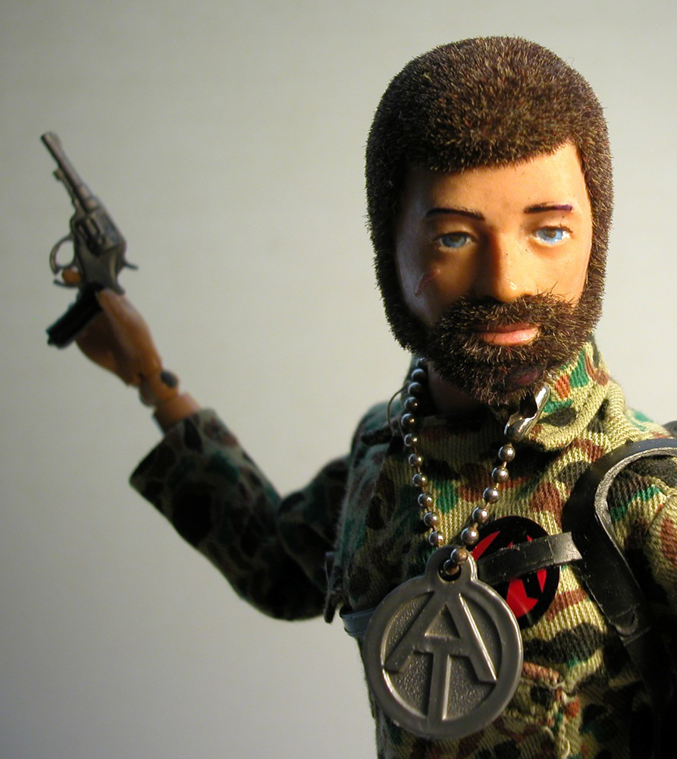
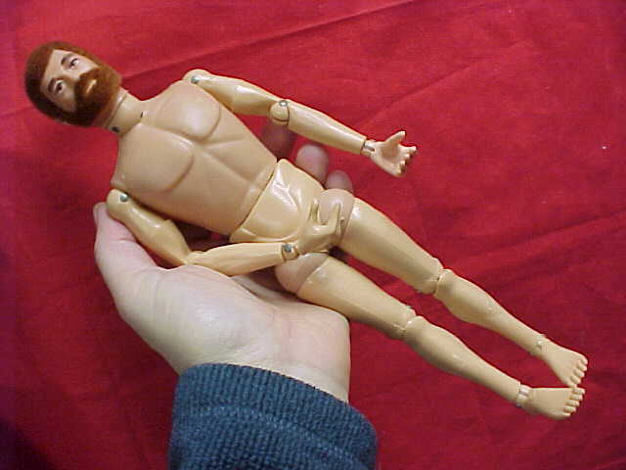
1970’s

Slide 32
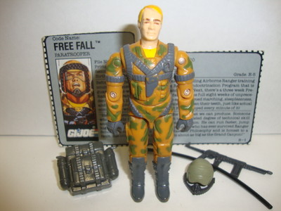
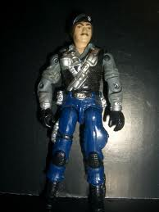
1990’s

Slide 33
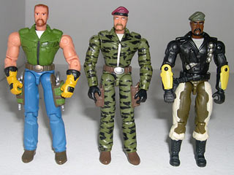
2000’s

