Slide 1
Eating Disorders
A high school workshop based presentation
Information taken directly from Teaching Students with Mental Health Disorders, Ministry of Education;
Understanding and Learning about Student Health, Rea and Catallozzi;
Anorexia, Bulimia and Other Childhood Eating Disorders, Kelty Mental Health Resource Centre

Slide 2
Let’s break the ice.
Counsellors: Diane Gorter and Martha Deitaker
Youth and Family workers: Lisa Roy, Mark Sheremeta, or Anne Field.
Eating disorder clinic:
If you are looking for a support group, please contact the Kelty Mental Health Resource Centre by calling 1-800-665-1822, or email us at keltycentre@bcmhs.bc.ca.
Anorexics and Bulimics Anonymous:
Tuesday 7-8:30pm Steps to Serenity
Blanshard Community Centre
901 Kings Road
Contact: Sarah 250.580.5224

Slide 3
Brainstorm and define.
Initiate the workshop with a class brainstorm. How many eating disorders can we list? What do we know about them?
Break into groups and have students create definitions for each disorder. We will return to this information later.

Slide 4
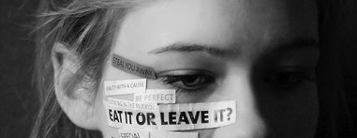
What are Eating Disorders?
An eating disorder is when a person experiences severe disturbances in eating behaviour such as extreme reduction of food intake or overeating, or feelings of intense distress or concern about body weight or shape. People with eating disorders are usually secretive about their eating, purging, or lack of eating.

Slide 5
There are two main types of eating disorders.
Anorexia Nervosa
Bulimia Nervosa

Slide 6
Anorexia Nervosa
Four diagnostic criteria:
Refusal to maintain weight within a normal range for height and age (less than 85% of expected body weight).
Intense fear of weight gain despite being underweight.
Severe body image disturbance in which body image is the predominant measure of self-worth with denial of the severity of the illness.
In girls who have gone through puberty, an absence of the menstrual cycle for greater than three cycles.

Slide 7
Anorexic behaviours.
A person suffering from anorexia nervosa may engage in these behaviours:
Approximately half of anorexic people will engage in bulimic behaviours.
Will eat very little, often from foods they consider “safe” (more on this later, with Orthorexia)
May perceive dieting to be the highest form of self control, be a perfectionist, and set extremely high goals for themselves.
Undertake rigid exercise regimes.
May shop and cook for others, but refuse to eat.
Gains attention from family and friends for their appearance or out of concern for their lack of nutrition and their health.
Maintains records of calorie intake, measures and weighs food.
Hoarding or hiding food.
Wearing loose and layered clothing.
Withdraw from social activities and becomes highly physical with repetitive activities.
Changes in behaviour that are not consistent with their personality.

Slide 8
The Psychology of Anorexia
Anxiety, depression, lack of control, defiant, stubborn, intense mood swings
Feelings of inadequacy, worthlessness, and loneliness.
Low self esteem, radical change in appearance, body language, or social relations.
Withdrawn, isolated.
Demonstrates inflexibility and resists changes to routine.
Fear of failure around perfectionist ideas, such as grades.
Denies anything is wrong.

Slide 9
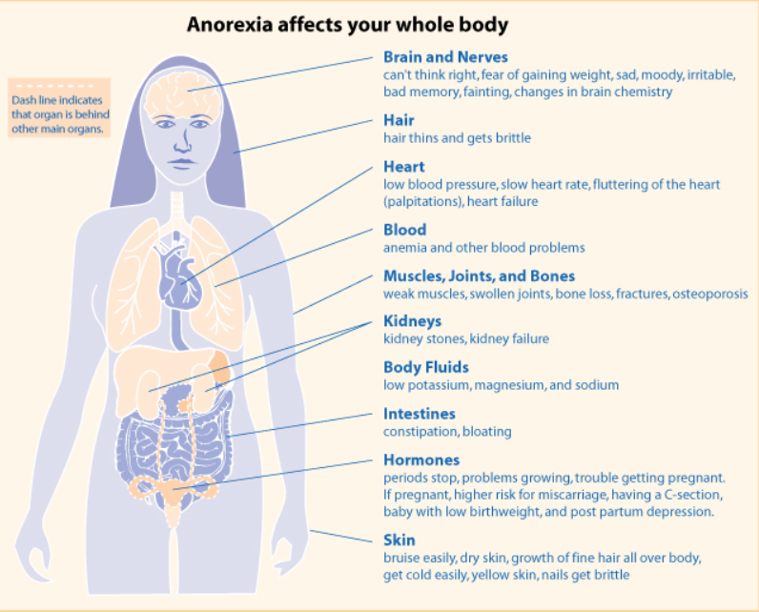
Physical changes with anorexia.
What I wish I could tell my 10 year old self about my eating disorder: http://newsthrive.com/post/what-i-wish-i-could-tell-my-10-year-old-self-about-my-eating-disorder_362466/
A person suffering from anorexia may exhibit these physical characteristics:
Weight loss, little muscle or fat.
Stomach problems, tremors, muscle cramps.
Dry, scaly skin, might be yellow or grey in colour.
Fine hair growth on face or body.
Dull, brittle, thinning hair.
Appears chronically tired and/or cold.
Severe dental problems, sometimes from vomiting.
Loss of menstruation, or lack of its onset in younger females.

Slide 10
Important things to know about Anorexia Nervosa.
Sufferers are not simply victims of a diet gone bad; they are suffering from an intense and irrational fear.
The destructiveness of the disorder is often denied.
The true prevalence of the disorder are unknown because many people do not know they are suffering from it.
It is estimated that between .5% and 1% of North American females suffer from the disorder.
Victims come from all walks of life, but the majority of reported cases are white, middle class women.
Adolescent girls are the most at risk.
Males make up 5-10% of sufferers. Some statistics put it at 20%.
It has serious consequences: in adults, it has one of the highest mortality rates (cardiac arrest, malnutrition, and suicide); because it arises often in adolescence when there is a high need for nutrients, it can have long lasting health consequences such as issues with menstruation, weakened immune system, stomach and heart problems, and chemical changes in the brain that can create or increase depression and anxiety levels.

Slide 11
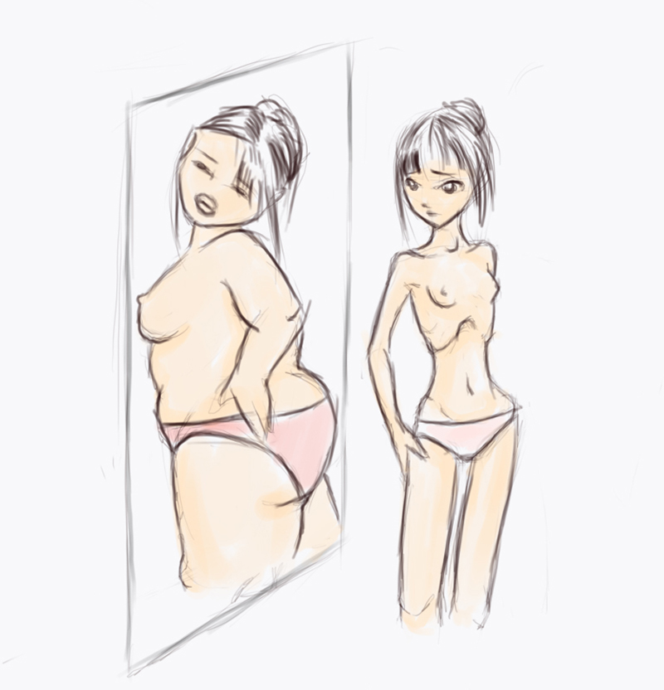
Body dysmorphic disorder is a type of chronic mental illness in which you can't stop thinking about a flaw in your appearance — a flaw that is either minor or imagined. But to you, your appearance seems so shameful that you don't want to be seen by anyone.
When you have body dysmorphic disorder, you intensely obsess over your appearance and body image, often for many hours a day. Your perceived flaw causes you significant distress, and your obsession impacts your ability to function in your daily life. You may seek out numerous cosmetic procedures or excessively exercise to try to "fix" your perceived flaw, but you're never satisfied. Body dysmorphic disorder is also known as dysmorphophobia, the fear of having a deformity.
Treatment of body dysmorphic disorder may include medication and cognitive behavioral therapy.
http://www.timescolonist.com/anorexia-survivor-launches-victoria-peer-support-group-1.1732480

Slide 12
Glamorisation?
Warning: the following video will be disturbing and may be triggering.
The “most anorexic woman in the world;” what is the problem with this title?
http://thecitizensoffashion.com/2013/01/09/valeria-levitinthe-worlds-thinnest-woman-campaigns-against-anorexia/
What is “thinspiration” or “thinspo’?
Inspiration which comes from someone who is very thin. A blend of the words 'thin' and ‘inspiration;’ such groups collect pictures of painfully skinny girls for “thinspiration,” compare dangerously low goal weights and measurements, and team up to “keep each other strong” in their quest to be thin.
What are the issues with it?
https://gainingitallback.wordpress.com/2012/01/10/10-reasons-people-shouldnt-use-thinspo/
An example of “Pro Ana”: http://bestanorexiatips.blogspot.ca/2014/02/pro-ana-tips-for-losing-weight-fast.html#.VteD9H0rLcs

Slide 13
Thigh Gap. Barbie. Rib removal.
Thigh Gap:
https://www.youtube.com/watch?v=L3D0jMIOK_c
Barbie: https://www.youtube.com/watch?v=BHqmQrITGpY
Severe body alteration:
https://www.youtube.com/watch?v=xNk7G3kw2oc

Slide 14
Bulimia Nervosa
Marked by binge eating (a greater amount of food that most people would eat in that time frame) followed by purging through self-induced vomiting, use of laxatives, excessive exercise, enemas, or medications.
A person feels a lack of control over the binge eating.
Fasting and excessive exercise.
Sufferers will set unreasonably strict diets. When they do not maintain these diets, they fall into episodes of intense eating followed by purging.
Unlike anorexic people, bulimic people are more likely to acknowlege the problem, but will not use this knowledge to initiate change but rather use it to confirm their own negative self image.
Self esteem is significantly affected by their perception of their weight.
Weight fluctuates frequently.
Warning: video may be triggering.
“Likeness” https://www.youtube.com/watch?v=dK3TyErAal8

Slide 15
Bulimic behaviours.
Often appear to be of average weight or even overweight due to the binge eating.
Preference given to high sugar junk foods during binge eating.
Often eats a restrictive diet or eats in private.
Frequently uses the bathroom after eating.
Engages in “acting out” behaviours, such as shoplifting, skipping school, drug use, sexual promiscuity.
Often appears socially outgoing; relationships tend to be superficial, however.

Slide 16
Bulimic Psychology
Sufferers are preoccupied with food: conversations, projects, artwork may revolve around food themes.
Difficulty concentrating, appears either indecisive or into “black and white” thinking.
Makes comments about being overweight and expresses a belief in self control when it comes to food.
Fears around personal relationships.
Shares many feelings with anorexic sufferers such as inadequacy, mood swings, depression, anger, anxiety, loneliness.

Slide 17
Physical Changes with Bulimia Nervosa.
Broad fluctuations in weight.
Dental problems, broken blood vessels from vomiting, bags under eyes, throat problems caused by vomiting.
Dehydration, fainting, tremors, blurred vision.
Stomach problems.
Loss of or irregular menstruation.

Slide 18
Binge Eating Disorder
In sharp contrast to the undereating of anorexic or bulimic individuals, chronic eaters go through long periods of overeating.
Do NOT engage in purging or other compensatory behaviours.
Sometimes called “compulsive eating” or “food addiction.”
Much more widespread than either anorexia or bulimia.
Males, people from a broad range of socioeconomic backgrounds, and a wide range of ages are affected.
People who binge eat are not always overweight and overweight people are not always binge eaters.

Slide 19
Binge Eating Characteristics.
A binge eater may:
Eat faster than normal
Eat until uncomfortably full.
Eat excessively even when they are not hungry.
Eats large amount of food throughout the day without planned meal times.
Eat alone because they are embarrassed by portion sizes.
Feel guilty, depressed, or disgusted with self.
Feel a lack of control.
Experiences binge eating episodes at least twice a week for six months, on average.

Slide 20
Things to know about Binge Eating
Binge eaters eat often in reaction to stress, conflict, and daily problems.
Usually overweight or obese.
Problems with increased risk of bone and joint problems and proneness to fractures.

Slide 21
Males and eating disorders.
http://www.eating-disorder.com/Eating-Treatment/Eating-Disorders/male-anorexia-eating-disorder.htm
Assignment: See Family and Gender studies folder.

Slide 22
Orthorexia: an obsession with eating foods that one considers healthy. a medical condition in which the sufferer systematically avoids specific foods in the belief that they are harmful.
http://www.takepart.com/video/2014/08/05/can-being-vegan-lead-disordered-eating
Elephant Journal: http://www.elephantjournal.com/2015/07/orthorexia-healing-from-disordered-eating/

Slide 23
What causes eating disorders?
Eating disorders are complex and their causes are not completely understood.
A number of factors contribute: genetics, family relationships, trauma, and individual cognitive styles such as achievement orientation or perfectionism.
Because they most often arise during adolescence, some developmental triggers may be present.
Body image and low self esteem and depression are all interconnected.
Disordered eating may be seen as an attempt to regain control.
Eating or not eating can be an attempt to have needs met.
Becomes a vicious cycle as the behaviour elevates the cognitive challenges associated with disordered eating such as anxiety, depression, low self esteem etc
People who have experienced abuse or a significant loss are more at risk.
People who come from highly stressful homes.
Participation in highly competitive activities that place an emphasis on the body size, such as gymnastics, ballet, modelling, and long distance running.

Slide 24
Other important things to note.
Scientists have moved away from the notion of a single cause and understand there is a number of factors that predispose a person to eating disorders.
Transition seems to be important: for example, moving from childhood to adolescence. It can arise as an attempt to delay physical and emotional maturation.
We live in a culture that values thinness, especially for women.
People who are seen as desirable or successful are often sleek, gaunt.
In the midst of the physical changes of puberty, many vulnerable and impressionable youth will struggle to reach unrealistic standards.

Slide 25
It is a continuum of severity.
From normal eating to disordered.
As disturbance in normal eating becomes more extreme, so does the individual’s sense of body dissatisfaction, interpersonal distrust, fear of maturing, and inability to regulate impulsive behaviours.
Patterns of self denial and self control become extreme.
Sometimes they can be almost undetectable and therefore, a person may not get any help.
You Don’t Have to Try: https://www.youtube.com/watch?v=GXoZLPSw8U8

Slide 26
Some other food or body related disorders.
Pica : Pica is persistently eating nonfood items, such as soap, cloth, talcum powder or dirt, over a period of at least one month. Eating such substances is not appropriate for the person’s developmental level and not part of a specific cultural or social practice.
Persistently eating these nonfood items can result in medical complications such as poisoning, intestinal problems or infections. Pica often occurs along with other disorders such as autism spectrum disorder or intellectual disability.
Rumination disorder: Rumination disorder is repeatedly and persistently regurgitating food after eating, but it’s not due to a medical condition or another eating disorder such as anorexia, bulimia or binge-eating disorder. Food is brought back up into the mouth without nausea or gagging. Sometimes regurgitated food is re-chewed and re-swallowed or spit out.
The disorder may result in malnutrition if the food is spit out or if the person eats significantly less to prevent the behavior. The occurrence of rumination disorder may be more common in infancy or in people who have an intellectual disability.
Avoidance/restrictive food intake disorder : This disorder is characterized by failing to meet your minimum daily nutrition requirements because you don’t have an interest in eating; you avoid food with certain sensory characteristics, such as color, texture, smell or taste; or you’re concerned about the consequences of eating, such as fear of choking. Food is not avoided because of fear of gaining weight.
Body dysmorphic disorder: a type of chronic mental illness in which a person cannot stop thinking about a flaw in their appearance, real or imagined.

Slide 27
The myths our culture perpetuates.
Beautiful https://www.youtube.com/watch?v=aoYEQgG4-JY
What media presents is a real picture of our culture.
Anybody can be slim.
Slender people are more successful and happy.
People who are oveweight become and remain so because of overeating and a lack of self control.
Being overweight is a health hazard.
Take a few minutes to free write your thoughts on these myths.

Slide 28
The truth behind the myths.

Slide 29
What can be done?
Why dieting doesn’t usually work: https://www.ted.com/talks/sandra_aamodt_why_dieting_doesn_t_usually_work
How can you help a friend who you suspect to be suffering?
Speak with a counsellor first.
Listen to your friend empathetically.
Communicate your care and concern.
Offer to help them seek help, such as going to a counsellor or doctor with them.
Avoid getting into a power struggle with them or arguing over it.
Recognise that eating disorders are about low self esteem, fea and often other unresolved issues.
Avoid commenting on their appearance, such as “you don’t look fat to me” or “you don’t have anything to worry about.” These comments heighten the focus on body size.
Avoid seeking blame.
Be patient.
Take care of yourself as well.

Slide 30
How can you change your self talk?
What is the Body Positivity movement?
http://everydayfeminism.com/2015/12/what-is-body-positvity/
Taryn Brumfitt:
Embrace trailer: https://www.youtube.com/watch?v=r6-hj3nCw10
https://bodyimagemovement.com.au/

Slide 31
Homework compliment assignment.
Taryn Brumfitt’s list:

